Slide 1


Analysis and Design of Algorithms
Transform Coding
Chapter 9: Greedy Algorithms
School of Software Engineering © Ye Luo

Slide 2
Content
The Introduction of Greedy Algorithms
  Change Making Problem
  Definition of Greedy Algorithm
  Category of Greedy Algorithms
Problems solved by Greedy Algorithms
  Fractional Knapsack Problem
  Single-source Shortest Paths problem
  Minimum Spanning Tree

Slide 3
Change Making Problem
  Problem Description (找零问题)
  Given unlimited amounts of coins d₁ > … > d_{m} , give the change for amount X with the least number of coins.
  Idea ---“Greedy” thinking
    Take the coin with largest denomination without exceeding the remaining amount of cents, it reduces the remaining amount the most
    Make the locally best choice at each step
Notes:
Denomination 面值

Slide 4
Change Making Problem
  Example 1
  How to make 48 cents of change using coins of
  d1=25 , d2=10 , d3=5 , d4=1
  so that the total number of coins is the smallest?
  Solution: 25, 10, 10, 1, 1, 1
What is the greedy strategy?
Notes:
Denomination 面值

Slide 5
Definition of Greedy Algorithms
Greedy Strategy
  A greedy algorithm makes a locally optimal choice step by step in the hope that a sequence of such choice will lead to a globally optimal solution.
    Constructing a solution through a sequence of steps
    Expanding a partially constructed solution obtained so far at this step
    Until a complete solution to the problem is reached
  The choice made at each step must be:
    Feasible -Satisfy the problem’s constraints
    Locally optimal -Be the best local choice among all feasible choices
    Irrevocable -Once made, choice can’t be changed on subsequent steps.
Notes:
贪心算法总是作出在当前看来最好的选择。
也就是说贪心算法并不从整体最优考虑，它所作出的选择只是在某种意义上的局部最优选择。
当然，希望贪心算法得到的最终结果也是整体最优的。
虽然贪心算法不能对所有问题都得到整体最优解，但对许多问题它能产生整体最优解。如单源最短路经问题，最小生成树问题等。
在一些情况下，即使贪心算法不能得到整体最优解，其最终结果却是最优解的很好近似。
必须满足：可行、局部最优、不可取消

Slide 6
Basic Steps of Greedy Algorithms
  General features of the problems solved by Greedy Alg.
The solution to the problem consists of a subset of N sequential inputs that satisfy some constraints. (问题的解由n个满足条件的序列输入构成)
  Basic steps of greedy method
  According to the question, choose a metric and sort the N inputs by this metric.
  If x_{n} (n<=N, the n^{th} input ) and the partial optimal solution( {x₁, x₂, …, x_{n-2}}) cannot be a feasible solution under this metric, then x_{n} is deleted and move to x_{n+1}.
  Otherwise, merge the current input into the partial solution to get a new partial solution ( {x₁, x₂, …, x_{n-2,} x_{n} }).
  This process continues until all N inputs have been considered, and then the subset of inputs recorded in the optimal solution set constitutes the optimal solution to the problem under this metric.
找零问题中的钱币面值
找钱超过应找数量

Slide 7
Change Making Problem
  Example 1
  How to make 48 cents of change using coins of
  d1=25 , d2=10 , d3=5 , d4=1
  so that the total number of coins is the smallest?
  Solution: 25, 10, 10, 1, 1, 1
  Is the solution globally optimal?
Yes
  Change Making Example 2
How to make 41 cents of change using coins of
d1=25 , d2=20 , d3=10 , d4=5, d5= 1
so that the total number of coins is the smallest?
Greedy Solution: 25, 10, 5, 1
No, optimal solution: 20, 20, 1
Notes:
Denomination 面值

Slide 8
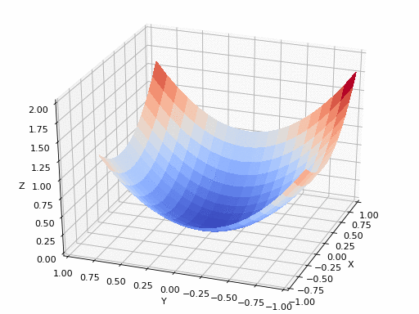
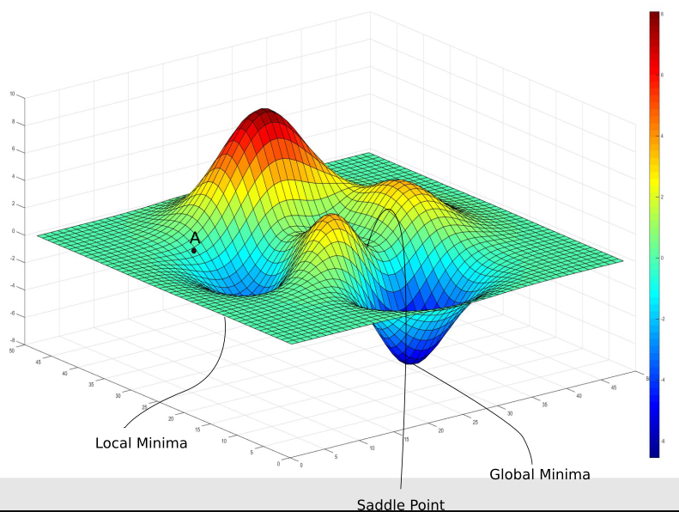
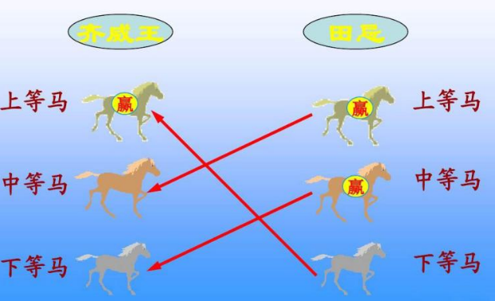
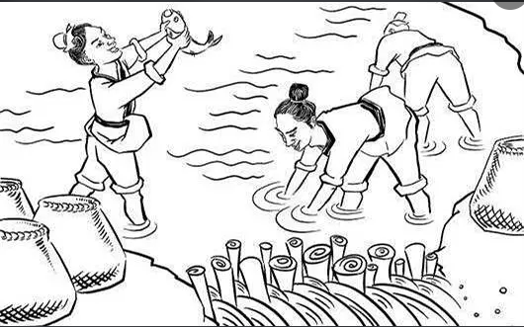
Greedy Algorithm v.s. Wisdom of Ancient Chinese
A.
v.s.
Ideal case
Practical case
做人做事要顾全大局，不能只贪图眼前的一点利益，要有大局意识。

Slide 9
Category of Greedy Algorithms
  For some problems, yields an optimal solution for every instance.
    Some instances of change making
    Minimum Spanning Tree (MST)
    Single-source shortest paths
    Huffman codes
  For most, does not, but can be useful for fast approximations.
    Traveling Salesman Problem (TSP)
    Knapsack problem
    Other optimization problems

Slide 10
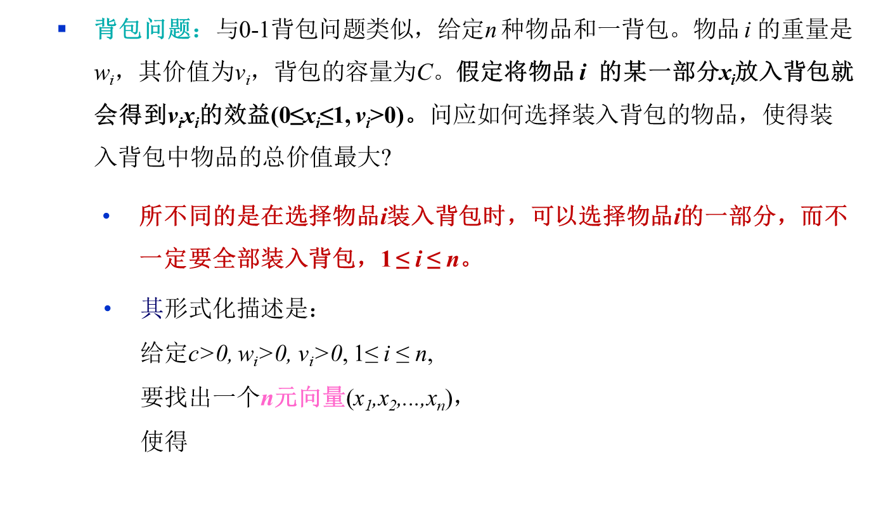
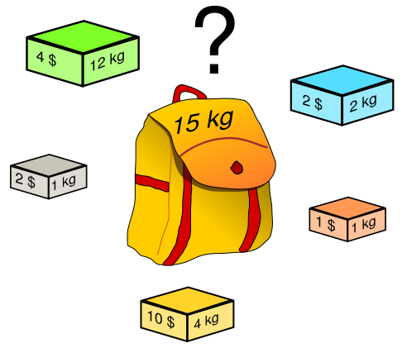

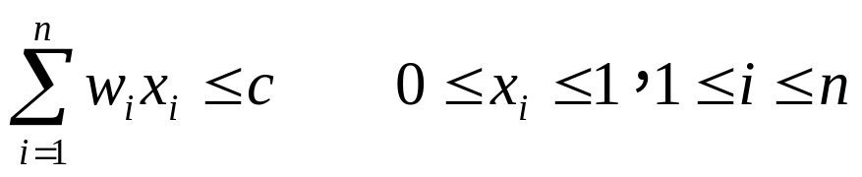
贪心策略解背包问题

Slide 11
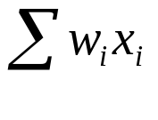
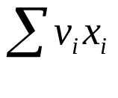
贪心策略解分数背包问题
  Example:
设，n=3，C=20，(v₁,v₂,v₃) = (25,24,15)， (w₁,w₂,w₃) = (18,15,10)。
可能的可行解有：
(x₁,x₂,x₃)
① (1/2,1/3,1/4) 16.5 24.25 //没有装满背包//
② (1, 2/15, 0 ) 20 28.2
③ (0, 2/3, 1) 20 31
④ (0, 1, 1/2) 20 31.5
  贪心策略下，以什么为度量标准，对物品进行排序依次放入背包呢，即贪心选择呢？

Slide 12
分数背包问题
  度量标准一：每装入一件物品，使背包获得最大的价值增量。
  该度量标准下的处理规则是：
按物品价值的非增次序将物品一件件地放入到背包；
如果正在考虑的物品放不进去，则只取其一部分装满背包：

Slide 13
贪心策略解分数背包问题
  Example:
  n=3，C=20，(v₁,v₂,v₃) = (25,24,15)， (w₁,w₂,w₃) = (18,15,10)。
∵ v₁>v₂> v₃
∴ 首先将物品1放入背包，此时x₁＝1，背包获得v₁＝25的利益增量，同时背包容量减少w₁＝18个单位，剩余空间ΔC=2。
其次考虑物品2和3。就ΔC=2而言有，只能选择物品2或3的一部分装入背包。
物品2： 若 x₂＝2/15， 则 v₂ x₂＝16/5＝3.1
物品3： 若 x₃＝2/10， 则 v₃ x₃＝3
为使背包的效益有最大的增量，应选择物品2的2/15装包，即x₂＝2/15
最后，背包装满， ΔC=0，物品3不装包，即x₃＝0 。
背包最终可以获得利益值＝ x₁ v₁ ＋x₂ v₂＋x₃ v₃ ＝ 28.2 (次优解,非问题的最优解)

Slide 14
贪心策略解分数背包问题
  度量标准二：以容量作为度量标准
  Problem: 以目标函数作为度量标准所存在的问题：尽管背包的利益值每次得到了最大的增加，但背包容量也过快地被消耗掉了，从而不能装入“更多”的物品。
  Solution: 让背包容量尽可能慢地消耗，从而可以尽量装入“较多”的物品。
  即，以容量作为度量
  该度量标准下的处理规则：
  按物品重量的非降次序将物品装入到背包；
  如果正在考虑的物品放不进去，则只取其一部分装满背包；

Slide 15
贪心策略解分数背包问题
  Example:
  n=3，C=20，(v₁,v₂,v₃) = (25,24,15)， (w₁,w₂,w₃) = (18,15,10)。
∵ w₃<w₂< w₁
∴ 首先将物品3放入背包，此时x₃＝1，背包获得v₃＝15的利益增量，同时背包容量减少w₃＝10个单位，剩余空间ΔC=10。
其次考虑物品2和1。就ΔC=10而言有，也只能选择物品2或1的一部分装入背包。
物品2： 若 x₂＝10/15， 则 v₂ x₂＝16
物品1： 若 x₁＝10/18， 则 v₁ x₁＝13.9
为使背包的效益有最大的增量，应选择物品2的10/15装包，即x₂=10/15
最后，背包装满ΔC=0，物品1将不能装入背包，故 x₁＝0 。
背包最终可以获得利益值＝ x₁ v₁ ＋x₂ v₂＋x₃ v₃ ＝ 31 (次优解,非问题的最优解)
存在的问题：效益值没有得到“最大程度”的增加

Slide 16
贪心策略解分数背包问题
  度量标准三：单位重量价值增量
  影响背包利益值的因素：
  背包的容量C
  放入背包中的物品的重量及其可能带来的利益值
  可能的策略是：在背包利益值的增长速率和背包容量消耗速率之间取得平衡，即每次装入的物品应使它所占用的每一单位容量能获得当前最大的单位利益。
  这种策略下的量度：已装入的物品的累计利益值与所用容量之比。
  Solution: 新的量度标准是：每次装入要使累计利益值与所用容量的比值有最多的增加（首次装入）和最小的减小（其后的装入）。
  此时，将按照物品的单位利益值：v_{i}/w_{i} 比值的非增次序考虑。

Slide 17
贪心策略解分数背包问题
  Example:
  n=3，C=20，(v₁,v₂,v₃) = (25,24,15)， (w₁,w₂,w₃) = (18,15,10)。
∵ v1/w1＜v3/w3 ＜v2/w2 ∴ 首先将物品2放入背包，此时x₂＝1，背包获得v₂＝24的利益增量，同时背包容量减少w₂＝15个单位，剩余空间ΔC=5。
其次，在剩下的物品1和3中，应选择物品3,且就ΔC=5而言有，只能放入物品3的一部分到背包中 。即 x₃＝5/10＝1/2；
最后，背包装满ΔC=0，物品1将不能装入背包，故x₁＝0 。
最终可以获得的背包利益值＝ x₁ v₁ ＋x₂ v₂＋x₃ v₃ ＝ 31.5 (最优解)
算法可视化 Demo

Slide 18
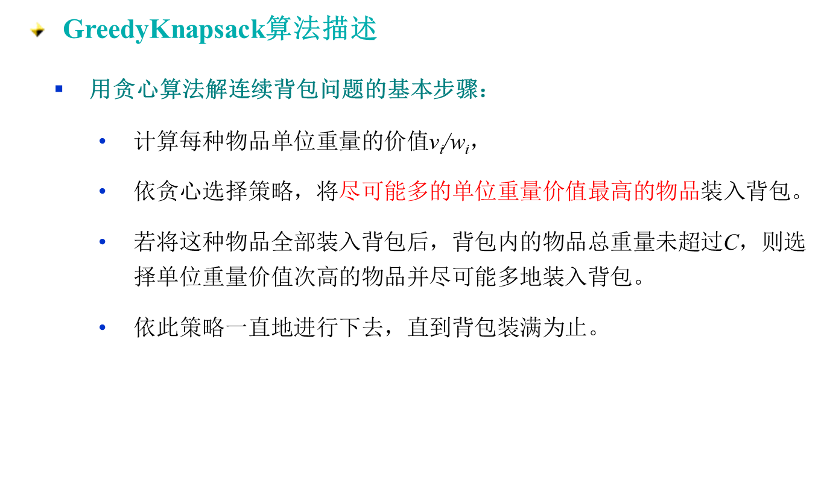
贪心策略解分数背包问题

Slide 19
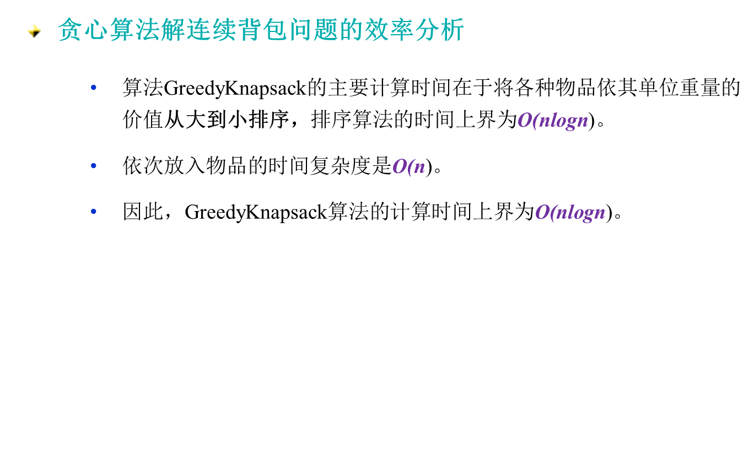
贪心策略解分数背包问题

Slide 20
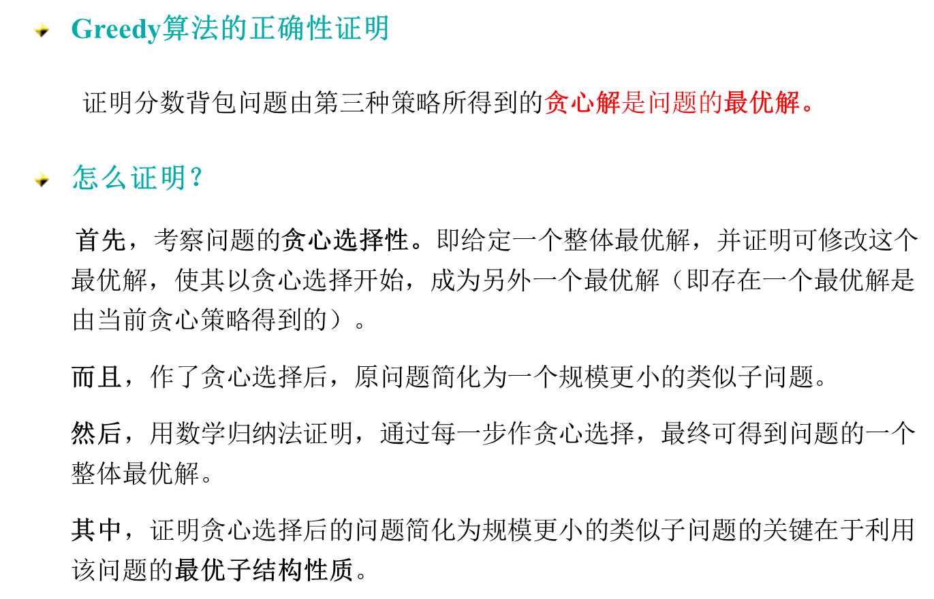
贪心解 的正确性证明

Slide 21
贪心解 是最优解的证明
  贪心选择性和最优子结构
  贪心选择性质（Greedy-choice property）：若原问题的整体最优解可以通过一系列局部最优的选择得到，即贪心选择来达到，则该问题称为具有贪心选择性质。
  最优子结构性质（ Optimal substructure ）：若一个问题的最优解包括它的子问题的最优解，则称其具有最优子结构性质。的的最优解，即问题具有最优子结构的性质。

Slide 22
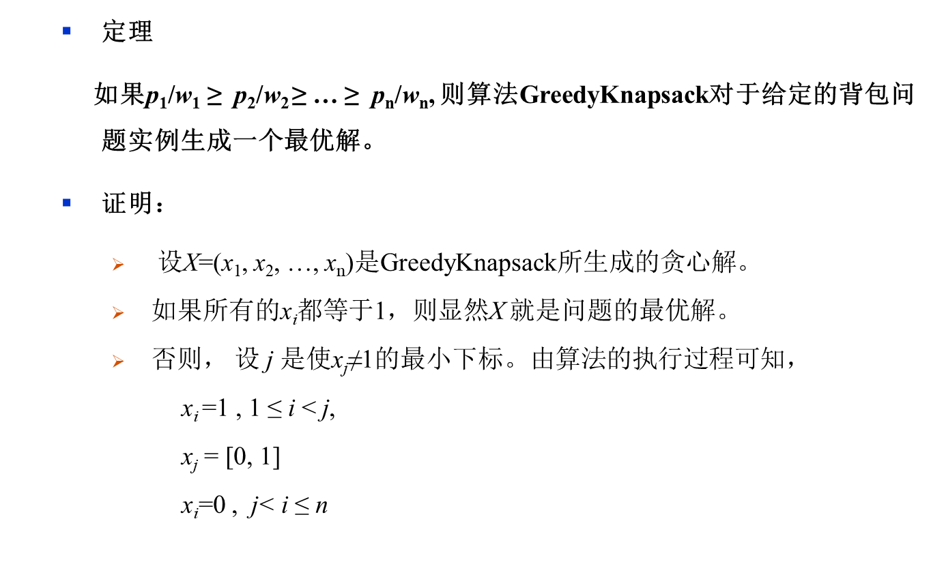
贪心算法解分数背包问题

Slide 23
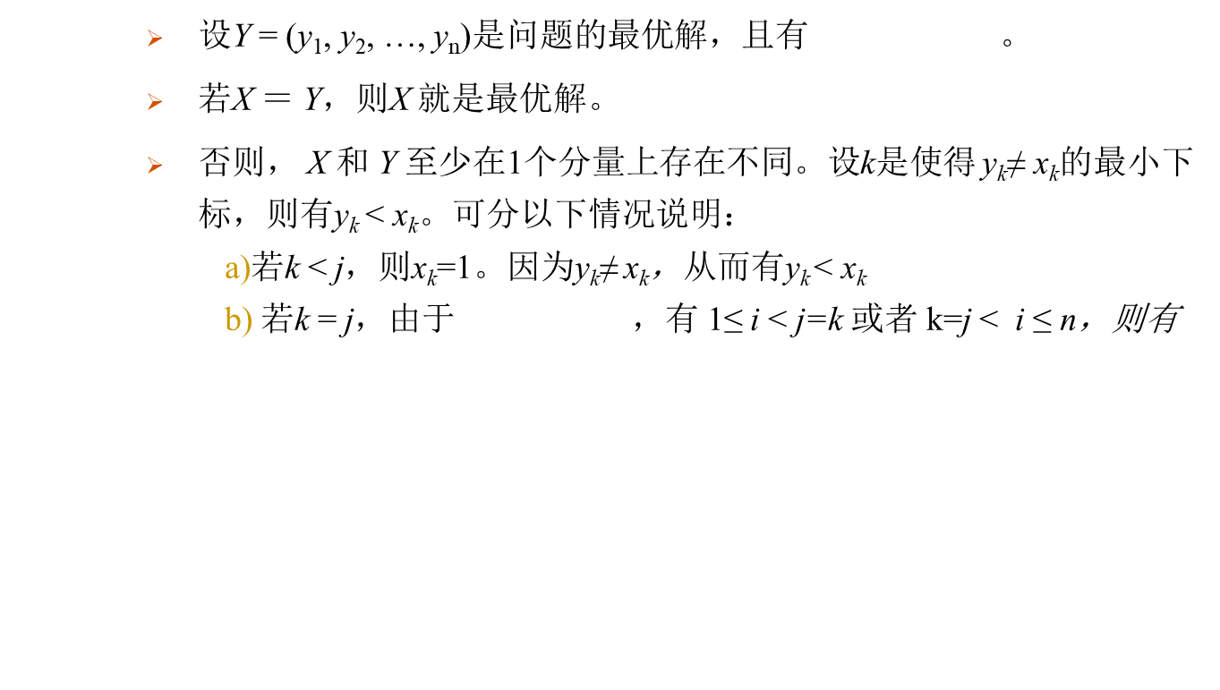


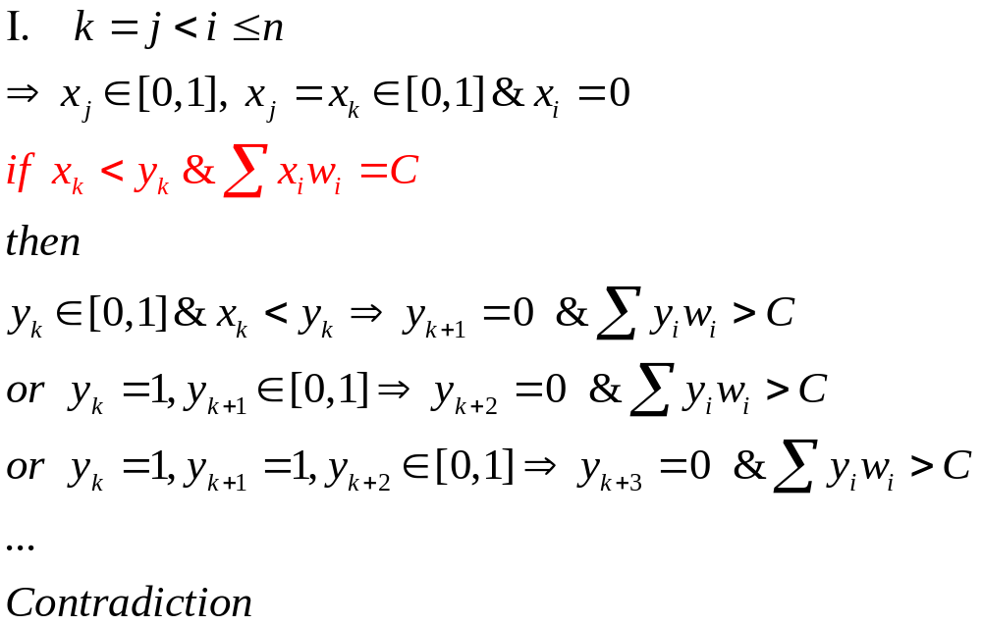
贪心算法解分数背包问题
1≤ i < j=k

Slide 24
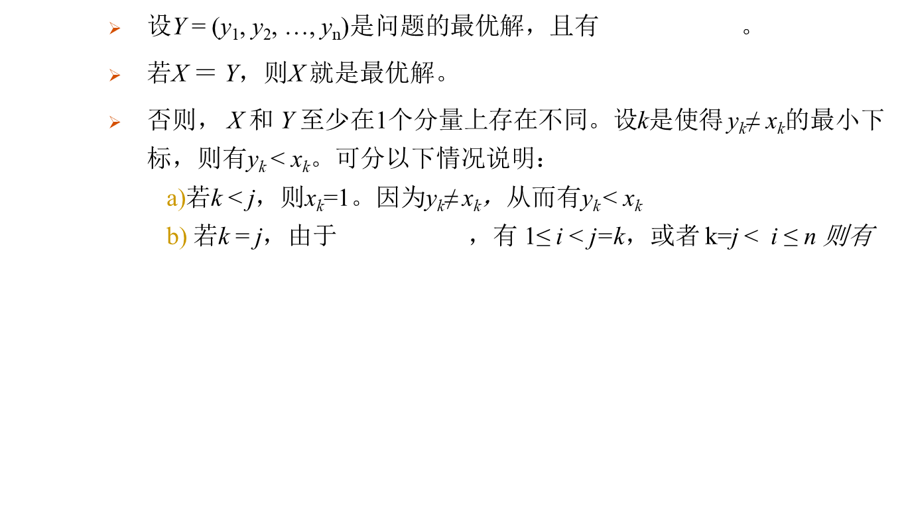


贪心算法解分数背包问题
若k > j，则 ，不能成立。

Slide 25
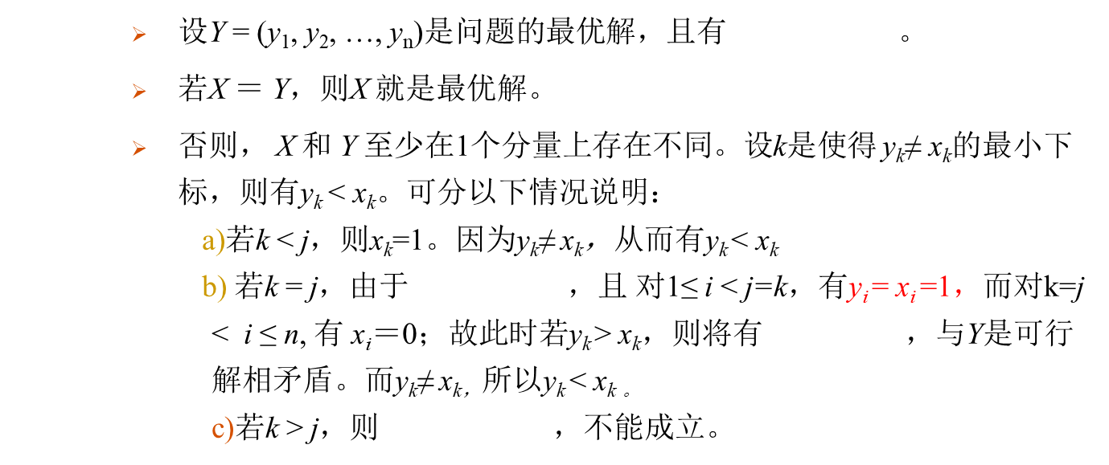

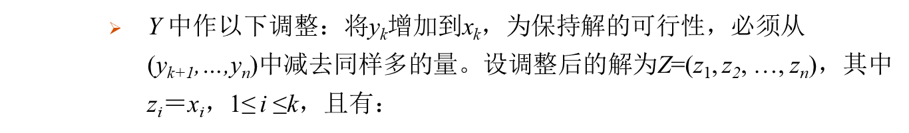
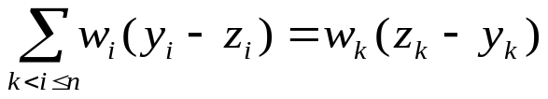
贪心算法解分数背包问题

Slide 26
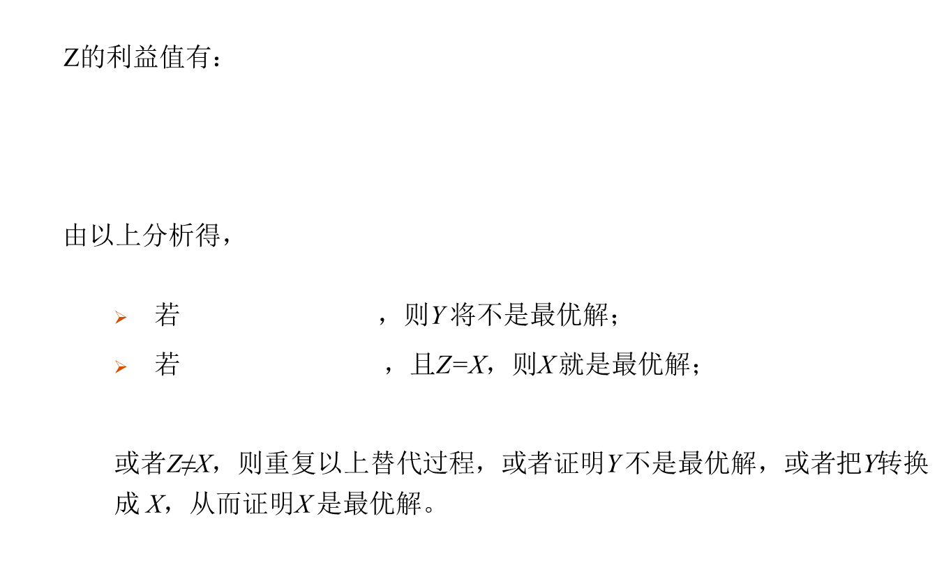
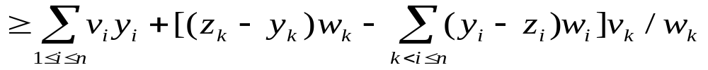
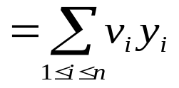
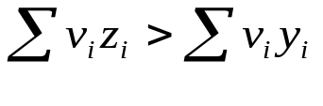

贪心算法解分数背包问题

Slide 27
Single-source Shortest Paths
4
a
b
Shortest Path Problems
  All pair shortest paths
  Floy’s algorithm
  Single Source Shortest Paths
  Dijkstra’s algorithm
  Given a weighted graph G, find the shortest paths from a source vertex s to each of the other vertices
  not a single shortest path that starts at the source and visits all the other vertices. e.g. traveling salesman
  Applications
  - transportation planning
  packet routing in communication networks
  finding shortest paths in social networks
  speech recognition, document formatting, robotics, compilers
  airline crew scheduling.
  path-finding in video games
3
2
5
6
7
4
c
d
e
Notes:
最短路径问题：
● 每对结点之间的路径问题
● 特定线路下的最短路径问题
● 单源最短路径问题等
单源最短路径问题
已知一个n结点有向图G=(V,E)和边的权函数c(e)，求由G中某指定结点v₀到其它各结点的最短路径。
假定边的权值为正。
Given a weighted graph G, find the shortest paths from a source vertex s to each of the other vertices.

Slide 28
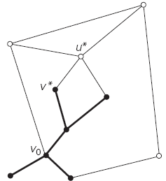
Single-source Shortest Paths
Dijkstra’s alg.
  undirected and directed graphs with nonnegative weights only
  one source vertex s
  to find the shortest paths from a source vertex s to each of the other vertices
  Idea of Dijkstra’s
  Start with a subtree consisting of a single source vertex
  a sequence of expanding subtrees, T₁, T₂, … --- one vertex/edge at a time
  In general, before its i^{th} iteration, the alg. has already identified the shortest paths to i -1 other vertices nearest to the source. These vertices, the source, and the edges of the shortest paths leading to them from the source form a subtree T_{i} ₋₁ of the given graph.
  Keep track of shortest path from source to each of the vertices in T_{i}

Slide 29
Single-source Shortest Paths
Dijkstra’s alg.
  Idea of Dijkstra’s
  On each iteration, T_{i}→ T_{i+1} connecting a vertex in tree (T_{i}) to one not yet in tree
  expands the current tree in the greedy
  the next vertex nearest to the source can be found among the vertices adjacent to the vertices of T_{i} .
  - referred to as “fringe vertices”; candidates from which Dijkstra’s algorithm selects the next vertex nearest to the source.
  Actually, all the other vertices can be treated as fringe vertices connected to tree vertices by edges of infinitely large weights

Slide 30
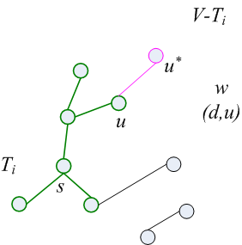

Single-source Shortest Paths
Dijkstra’s alg.
  Idea of Dijkstra’s (‘cont)
  label each vertex w with two labels.
  The numeric label d indicates the length of the shortest path from the source to this vertex found by the algorithm so far
  The other label u indicates the name of the next-to-last vertex on such a path, i.e., the parent of the vertex in the tree being constructed.
  finding the next nearest vertex u∗ becomes a simple task of finding a fringe vertex with the smallest d value.
  the sum of
  the distance to the nearest tree vertex u , i.e. weight of the edge c(w, u)
  and, the length of the shortest path from the source to u (previously determined by the algorithm), i.e. d[u]
  → edge (u*,u) with lowest d[u] + c(u*, u)
  stops when all vertices are included.

Slide 31
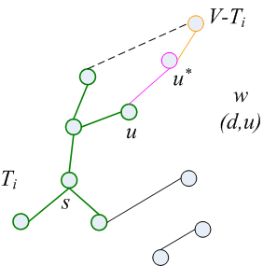
Single-source Shortest Paths
Dijkstra’s alg.
  Idea of Dijkstra’s (‘cont)
  After we have identified a vertex u∗ to be added to the tree, make some modification to other fringe vertices
  Move u∗ from the fringe to the set of tree vertices.
  For each remaining fringe vertex w that is connected to u∗ by an edge of weight c(u∗, w) such that d[u∗] + c(u∗, w) < d[w], update the labels of w by u∗ and d[u∗] + c(u∗, w), respectively.

Slide 32
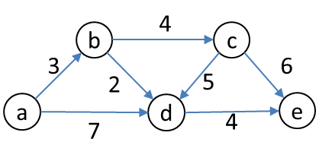
Single-source Shortest Paths
  Example : Dijkstra’s
4
b
c
Tree vertices | Remaining vertices
a(-,0) | b(a,3) c(-,∞) d(a,7) e(-,∞)
b(a,3) | c(b,3+4) d(b,3+2) e(-,∞)
d(b,5) | c(b,7) e(d,5+4)
c(b,7) | e(d,9)
e(d,9)
3
2
6
5
a
7
d
4
e
b
4
c
3
6
2
5
a
7
d
4
e
b
4
c
3
6
The shortest paths (identified by following nonnumeric labels backward from a destination vertex in the left column to the source) and their lengths (given by numeric labels of the tree vertices) are as follows:
from a to b : a − b of length 3
from a to d : a − b − d of length 5
from a to c : a − b − c of length 7
from a to e : a − b − d − e of length 9
2
5
a
7
d
4
e
4
b
c
3
6
2
5
a
7
d
4
e

Slide 33
Single-source Shortest Paths
  Dijkstra 算法的贪心选择性质
  Dijkstra 算法的贪心选择是从V-S中选择具有最短特殊路径的顶点u，从而确定从源v₀到u的最短路径长度dist[u] 。
  是最优解吗？有无从源v₀到u的更短的其它路径？
  如果存在一条从源v₀到u且长度比dist[u]更短的路，设这条路初次走出S外到达的顶点为x∈ V-S，然后徘徊于S内外若干次，最后离开S到达u。
  dist[x]≤ d(v₀,x)
  d(v₀,x) + d(x,u) = d(v₀,u) < dist (u)
  利用边的非负性可知d(x,u) ≥ 0，⇨ dist[x] < dist[u]。
  矛盾！
u
v₀
x

Slide 34
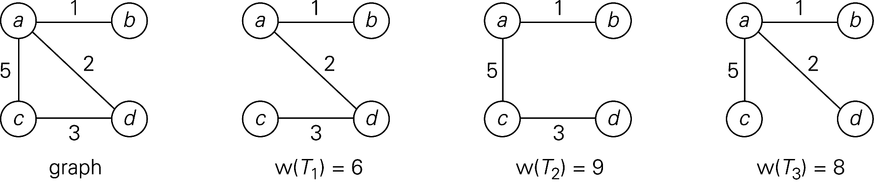
Minimum Spanning Tree
Problem:
  G =(V,E): undirected connected graph。
  edge weights for (v,w)∈ E
  Spanning Tree: a connected acyclic subgraph (tree) of G that includes all of G’s vertices
  Note: a spanning tree with n vertices has exactly n-1 edges.
  weight of a tree: the sum of the weights on all its edges
  minimum spanning tree: spanning tree of the smallest weight

Slide 35
Minimum Spanning Tree
Applications
  problem: given n points, connect them in the cheapest possible way so that there will be a path between every pair of points.
  design of all kinds of networks by providing the cheapest way to achieve connectivity
  communication, computer, transportation, electrical
  identifies clusters of points in data sets
  classification purposes in archeology, biology, sociology,
  → minimum spanning tree
  the points ----- vertices of a graph
  connections ---- the graph’s edges
  connection costs ---- the edge weights
Notes:
网络的最小生成树在实际中有广泛应用。例如，在设计通信网络时，用图的顶点表示城市，用边(v,w)的权c[v][w]表示建立城市v和城市w之间的通信线路所需的费用，则最小生成树就给出了建立通信网络的最经济的方案。

Slide 36
Minimum Spanning Tree
Problem:
  MST problem: Given a connected, undirected, weighted graph G= (V, E), find a minimum spanning tree for it.
  Compute MST through Brute Force?
  Brute force
  - generate all possible spanning trees for the given graph.
  - find the one with minimum total weight.
  Feasibility of Brute force
  - Possible too many trees (exponential for dense graphs)
  Kruskal: 1956, Prim: 1957

Slide 37
Minimum Spanning Tree
Prim
  Idea of Prim
  initial subtree T₀ consists of a single vertex selected arbitrarily from set V.
  a sequence of expanding subtrees, T₁, T_{2 …} --- one vertex/edge at a time
  T_{i-1}→ T_{i} each stage
  expands the current tree in the greedy
  On each iteration, attaching to tree the nearest vertex not in that tree.
  the nearest vertex: a vertex not in the tree, and connected to a vertex in the tree by an edge of the smallest weight.
  stops after all the graph’s vertices have been included in the spanning tree
  the algorithm expands a tree by exactly one vertex on each of its iterations, the total number of such iterations is n − 1, where n is the number of vertices in the graph.
  The tree generated by the algorithm is obtained as the set of edges used for the tree expansions.
Notes:
设G=(V,E)是连通带权图，V={1,2,…,n}。
首先置S ={1}，
然后，只要S是V的真子集，就作如下的贪心选择：
i∈S，j∈V-S，且c[i][j]最小的边，将顶点j添加到S中。
一直进行到S=V时为止。
利用最小生成树性质和数学归纳法容易证明：边集合T始终包含G的某棵最小生成树中的边。因此，在算法结束时，T中的所有边构成G的一棵最小生成树。

Slide 38
Minimum Spanning Tree
  Prim -I
ALGORITHM Prim(G)
//Prim’s algorithm for constructing a minimum spanning tree
//Input: A weighted connected graph G = (V, E)
//Output: E_{T}, the set of edges composing a minimum spanning tree of G
V_{T} ← {v₀} //v₀ can be arbitrarily selected
E_{T} ← φ
for i ←1 to |V|-1 do
find a minimum-weight edge e* = (v*, u*) among all the edges (v, u) such that v is in V_{T} and u is in V-V_{T}
V_{T} ← V_{T} ∪{u*}
E_{T} ← E_{T} ∪{e*}
return E_{T}

Slide 39
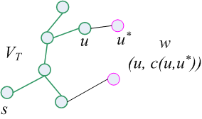
Minimum Spanning Tree
  Idea of Prim (‘cont)
  How to find the minimum weight edge that connecting a vertex in tree T_{i-1} to a vertex not yet in the tree ?
  → attaching two labels to a vertex:
  - the name of the nearest tree vertex
  - the length (the weight) of the corresponding edge
  finding the next vertex to be added to the current tree T_{i} = (V_{T}, E_{T})
  ↔ finding a vertex with the smallest distance label in the set V − V_{T}
  u∈ V_{T} ， u∗ ∈V-V_{T} ，min{ c[u, u∗ ] }
  After we have identified a vertex u∗ , make some modification to u’s neighbors
  Move u∗ from the set V − V_{T} to the set of tree vertices V_{T} .
  For each remaining vertex w in V − V_{T} that is connected to u∗ by a shorter edge than the u’s current distance label, update its labels by u∗ and the weight of the edge between u∗ and u, respectively.

Slide 40
Minimum Spanning Tree
  Prim is greedy
  The choice of edges added to current subtree satisfying the three properties of greedy algorithms.
  Feasible, each edge added to the tree does not result in a cycle, guarantee that the final ET is a spanning tree
  Local optimal, each edge selected to the tree is always the one with minimum weight among all the edges crossing V_{T} and V-V_{T}
  Irrevocable, once an edge is added to the tree, it is not removed in subsequent steps.

Slide 41
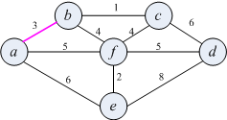
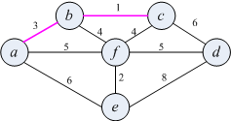
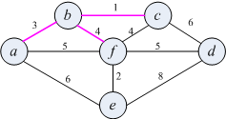
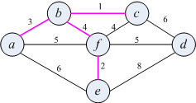
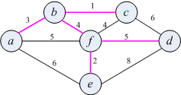
Minimum Spanning Tree
  Example : Prim
Tree vertices | Remaining vertices
a(-,0) | b(a,3) c(-,∞) d(-, ∞) e(a,6) f(a,5)
b(a,3) | c(b,1) d(-, ∞) e(a,6) f(b,4)
c(b,1) | d(c, 6) e(a,6) f(b,4)
f(b,4) | d(f, 5) e(f,2)
e(f,2) | d(f, 5)
d(f, 5)

Slide 42
Minimum Spanning Tree
Kruskal’s algorithm
  Idea of Kruskal’s
  looks at a minimum spanning tree of a weighted connected graph G =(V,E)_x000c_ as an acyclic subgraph with |V| − 1 edges for which the sum of the edge weights is the smallest.
  sorting the graph’s edges in nondecreasing order of their weights.
  starting with the empty subgraph, it scans this sorted list,
  adding the next edge on the list to the current subgraph if such an inclusion does not create a cycle and simply skipping the edge otherwise.
  - need efficient way of detecting/avoiding cycles
  algorithm stops when all vertices are included

Slide 43
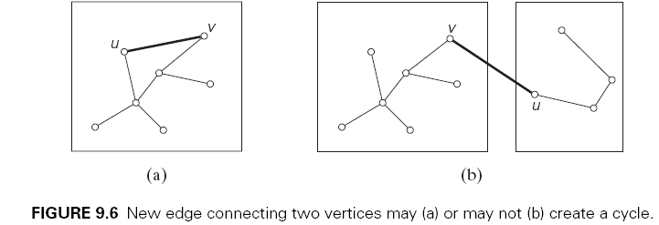
Minimum Spanning Tree
  Kruskal’s Algorithm (Advanced Part)
  Some reviews:
  Kruskal’s algorithm has to check whether the addition of the next edge to the edges already selected would create a cycle.
  a new cycle is created ↔ the new edge connects two vertices already connected by a path, ↔ the two vertices belong to the same connected component (Figure 9.6).
  Note also that each connected component of a subgraph generated by Kruskal’s algorithm is a tree because it has no cycles.

Slide 44
Minimum Spanning Tree
  Kruskal’s Algorithm (Advanced Part)
  Kruskal’s alg. with a slightly different interpretation.
  consider the algorithm’s operations as a progression through a series of forests containing all the vertices of a given graph and some of its edges.
  The initial forest consists of |V | trivial trees, each comprising a single vertex of the graph. The final forest consists of a single tree, MST
  On each iteration, the algorithm takes the next edge (u, v) from the sorted list of the graph’s edges,
  finds the trees containing the vertices u and v, and, if these trees are not the same, unites them in a larger tree by adding the edge (u, v).
  union-find algorithms..

Slide 45
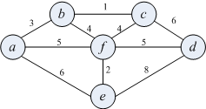
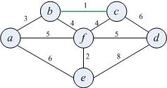
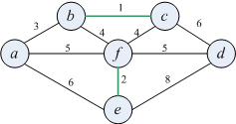
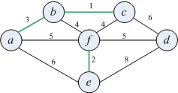
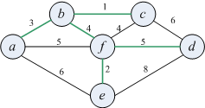
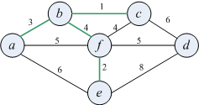
Minimum Spanning Tree
  Example: Kruskal’s
Tree edges | Sorted list of edges
 | bc | ef | ab | bf | cf | af | df | ae | cd | de
 | 1 | 2 | 3 | 4 | 4 | 5 | 5 | 6 | 6 | 8
bc
1
ef
2
ab
3
bf
4
df
5

Slide 46
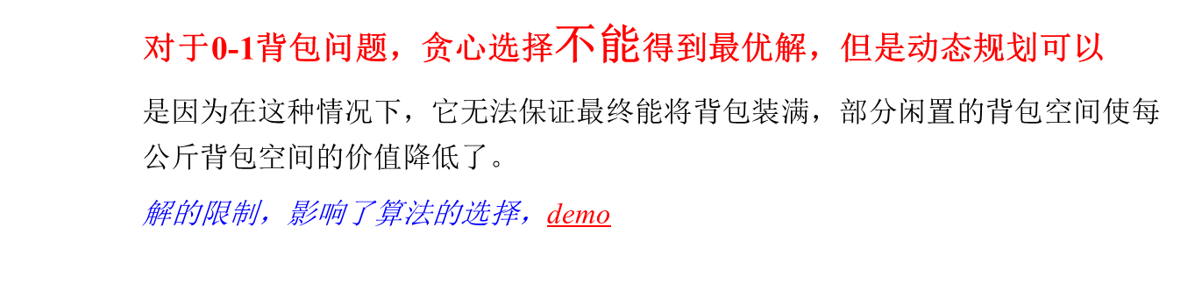
0-1背包 v.s. 分数背包
50
30
20
2/3
x3
3
30
2
30
20
x3
20
x3
1
x2
20
x2
20
10
x1
10
x1
10
x2
10
x1
￥60
￥100
￥120
背包
￥160
￥180
￥240=
60+100+80
￥220
0-1背包
分数背包

Slide 47
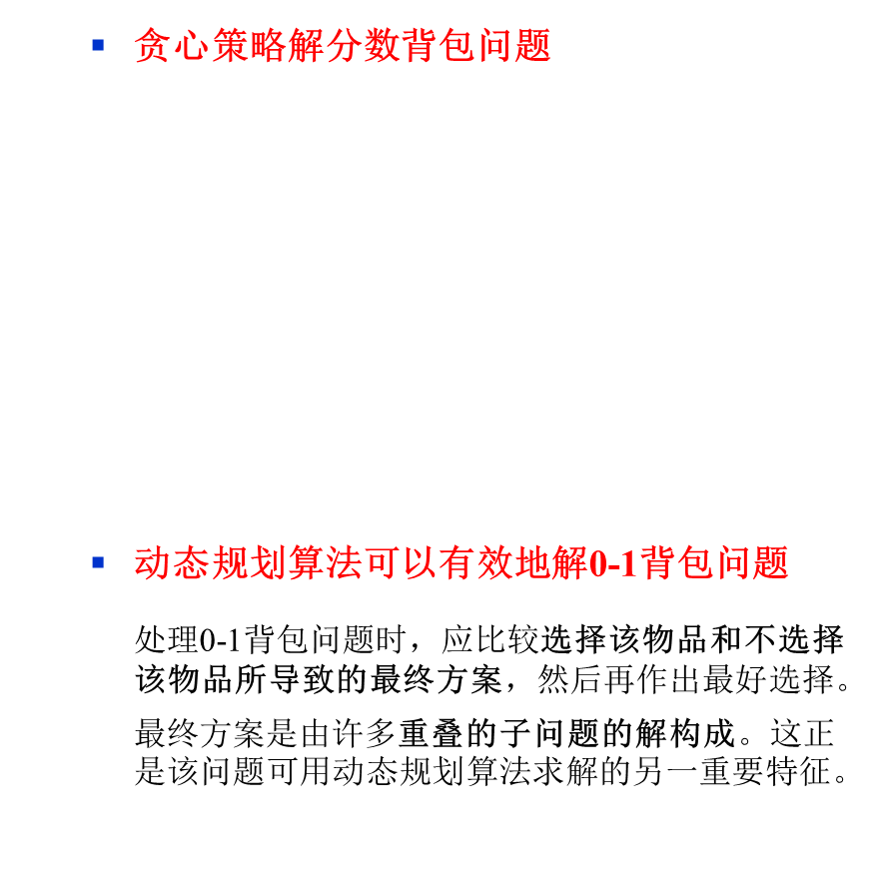
贪心算法 和 动态规划
20
50
3
20
2
30
60/10 > 100/20 > 120/30
v1/w1 > v2/w2 > v3/w3
1
20
10
10
￥60
￥100
￥120
￥240=
60+100+80
背包
 |  | 0 | w-w_{i} | …… | j | W
 | 0 | 0 | 0 |  | 0 | 0
w_{i} v_{i} | i-1 | 0 | V[i-1, w-w_{i}] |  | V[i-1, w]
 | i | 0 | 0 |  | V[i,w]
 |  | 0
 | n | 0 |  |  |  | Target

Slide 48
DP v.s. Greedy Algorithms
  贪心选择性
  具有贪心选择性则能得到全局最优解，即存在一个最优解是通过当前贪心选择策略得到的。
 | 动态规划（DP） | 贪心算法（Greedy Method)
子问题上 | 每步所做的选择往往依赖于子问题的解，只有在解出相关子问题后才能作出选择 | 仅在当前状态下作出最好选择，即局部最优选择，然后再去作出这个选择后产生的相应的子问题，不依赖于子问题的解
求解方式 | 通常以自底向上的方式解各子问题 | 通常以自顶向下的方式进行，以迭代的方式作出相继的贪心选择，每作一次贪心选择就将所求问题简化为规模更小的子问题

Slide 49
DP v.s. Greedy Algorithms
  最优子结构性质：与动态规划的相似性
原问题的最优解包含子问题的最优解，即问题具有最优子结构的性质。
在背包问题中，第一次选择单位质量上价值最大的货物，它是第一个子问题的最优解，第二次选择剩下的货物中单位重量上价值最大的货物，同样是第二个子问题的最优解，依次类推。

